Slide 1

Team Name : Spooky AI
Team Leader Name :Narendra Venkatesan
Problem Statement :Develop a robust, workable Proof of Concept that doesn't just filter, but intelligently ranks candidates.

Slide 2
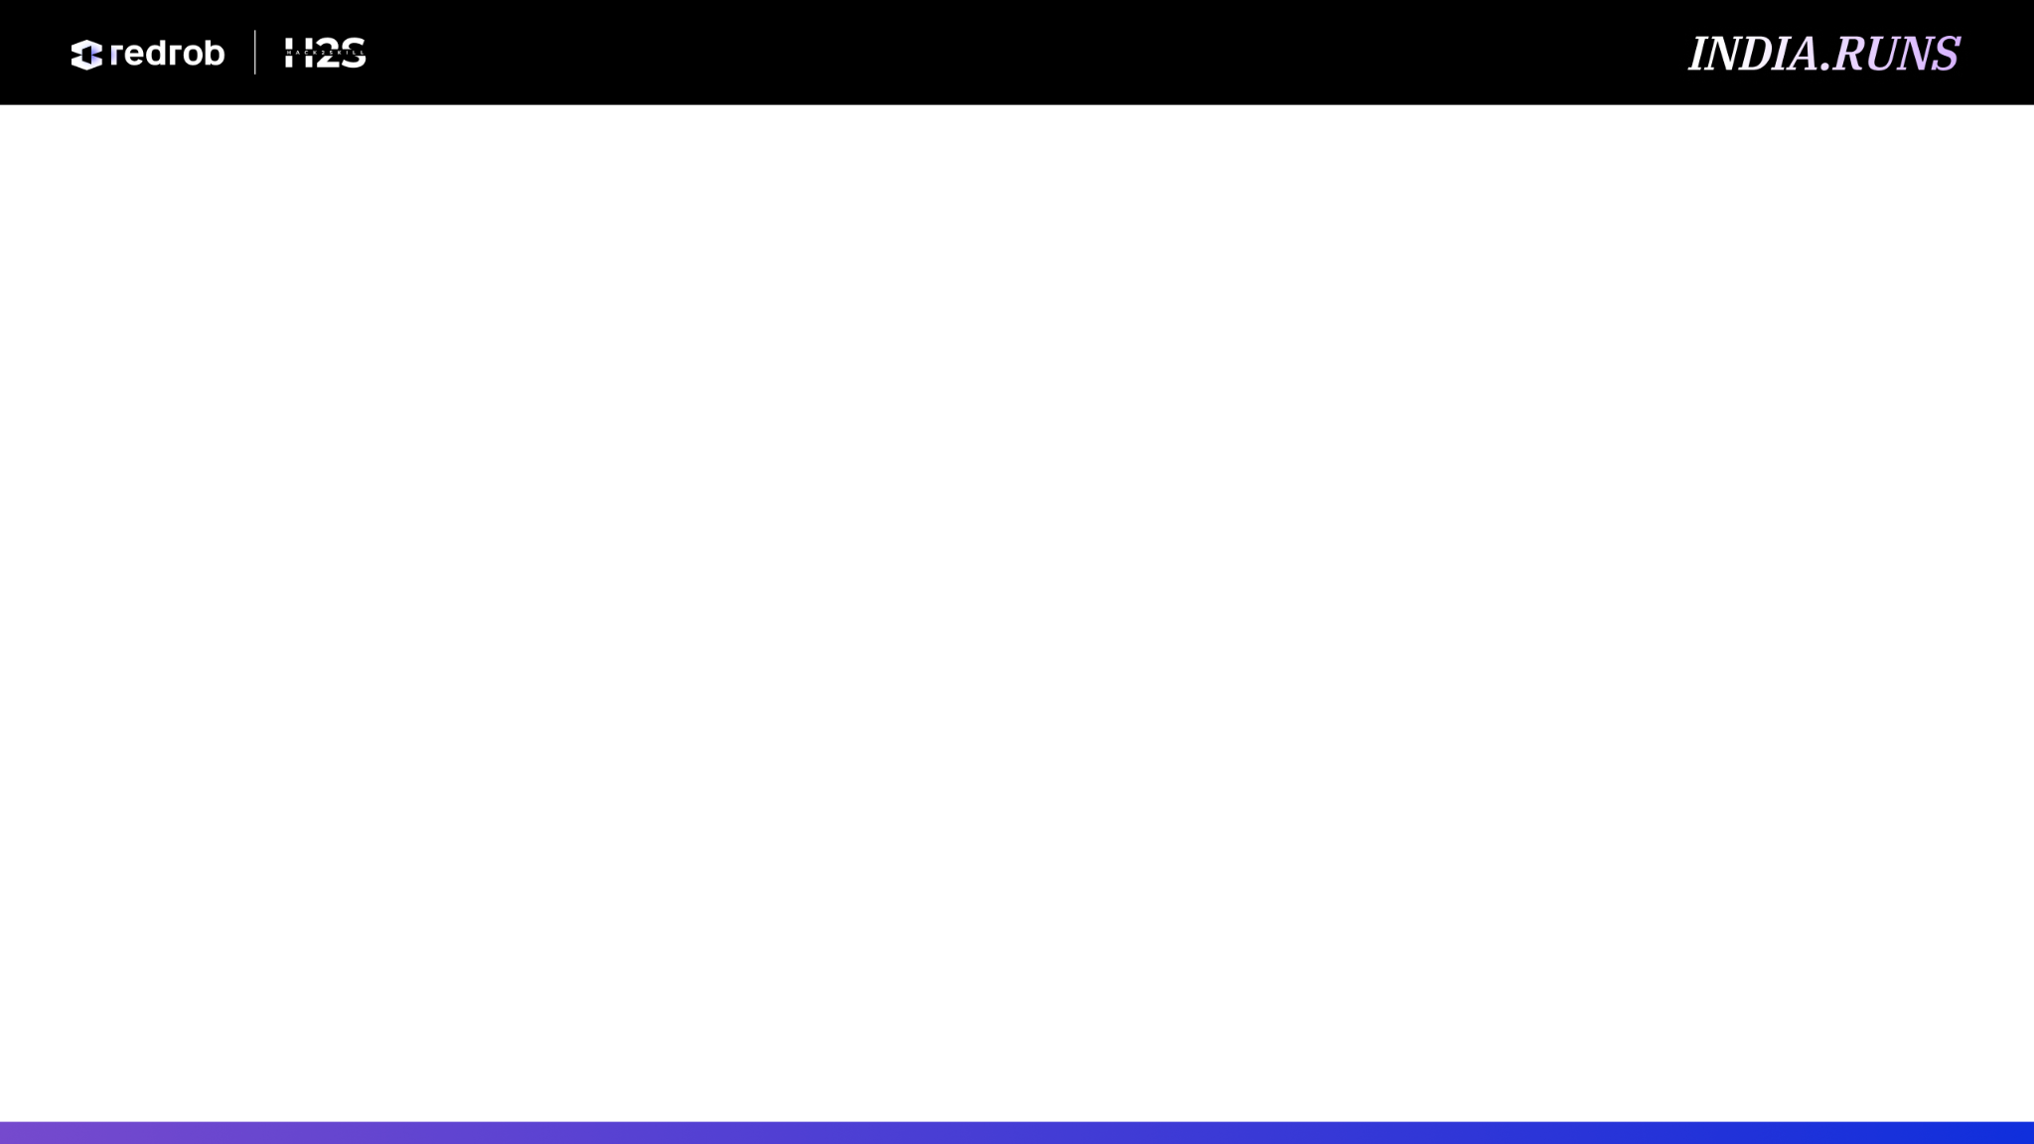
Solution Overview
What is your proposed solution?
What differentiates your approach from traditional candidate matching systems?

Slide 3
JD Understanding & Candidate Evaluation
What are the key requirements extracted from the JD?
Which candidate signals are most important for determining relevance? / How does your solution evaluate candidate fit beyond keyword matching?

Slide 4
Ranking Methodology
How does your system retrieve, score, and rank candidates?
What models, algorithms, or heuristics are used?
How are multiple candidate signals combined into a final ranking?

Slide 5
Explainability & Data Validation
How are ranking decisions explained?
How do you prevent hallucinations or unsupported justifications?
How does your solution handle inconsistent, low-quality, or suspicious profiles?

Slide 6
End-to-End Workflow
What is the complete workflow from JD input to ranked candidate output?

Slide 7
System Architecture

Slide 8
Results & Performance
What results or insights demonstrate ranking quality?
How does your solution meet the challenge's runtime and compute constraints?

Slide 9
Technologies Used
What technologies, frameworks, and tools were used and why were they
selected for this solution?

Slide 10
Submission Assets
Github video etc

Slide 11


